Slide 1
Transformer approach to Kalman-Filter
Version 1 Idan Daniel & Mor Keshet

Slide 2
Agenda
Introduction
Related Works
Our Approach (Method)
Examples
Results

Slide 3
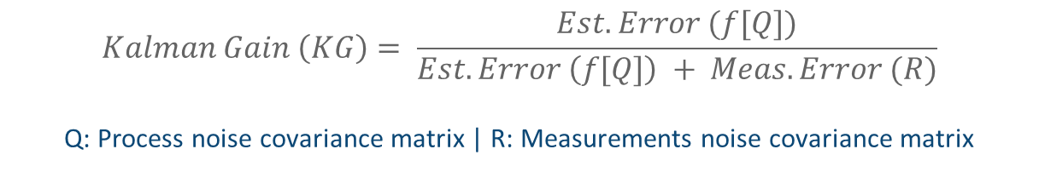
Introduction: Kalman Filter
A Kalman Filter (KF) is a recursive estimation algorithm, which is a widely-used method for linear filtering and prediction such object tracking
KF assumes known and linear motion and observation models, with i.i.d and normally-distributed noise, which indeed yield optimal tracking. But these assumptions are quite restrictive and are often not applied to real-world problems.
The parameters Q, R representing the covariance matrices of the noise in the motion model and in the observation model
$$Kalman Gain \left(KG\right)= \frac{Est. Error (f[Q])}{Est. Error \left(f[Q]\right) + Meas. Error (R)}$$
Q: Process noise covariance matrix | R: Measurements noise covariance matrix

Slide 4
Introduction: Extended Kalman Filter
Extended Kalman filter (EKF) is the nonlinear version of the Kalman filter which linearizes about an estimate of the current mean and covariance.
In the EKF, the state transition and observation models don't need to be linear functions of the state but may instead be differentiable functions

Slide 5
Introduction: GRU - Recurrent Neural Networks
Gated Recurrent Units (GRUs) are a gating mechanism in RNNs (introduced in 2014)
The GRU is a special type of optimized LSTM, but has fewer parameters, as it lacks an output gate
GRU's performance on certain tasks was found to be similar that of LSTM but have been shown to exhibit better performance on certain smaller and less frequent datasets

Slide 6
Introduction: Transformers
Transformers are a deep learning model, which are designed to process sequential input data (introduced in 2017 by Google)
Stanford researchers: “foundation models” (August 2021 paper) because they see them driving a paradigm shift in AI
Not like RNN, Transformers uses recursion, by processing sentences as a whole and by learning relationships between words thanks to the “attention” mechanism
→ Faster data processing

Slide 7
Related Works
We developed our method based on two related works:
“Using Kalman Filter The Right Way: Noise Estimation Is Not Optimal” - Gradient-based optimization to Q & R, based on “Cholesky” decomposition. using “Adam” algorithm
“KalmanNet: Neural Network Aided Kalman Filtering for Partially Known Dynamics” - RNN with GRU units separately to calculate Kalman Gain
Our net architecture was based on [ii], by replacing the net with transformers

Slide 8
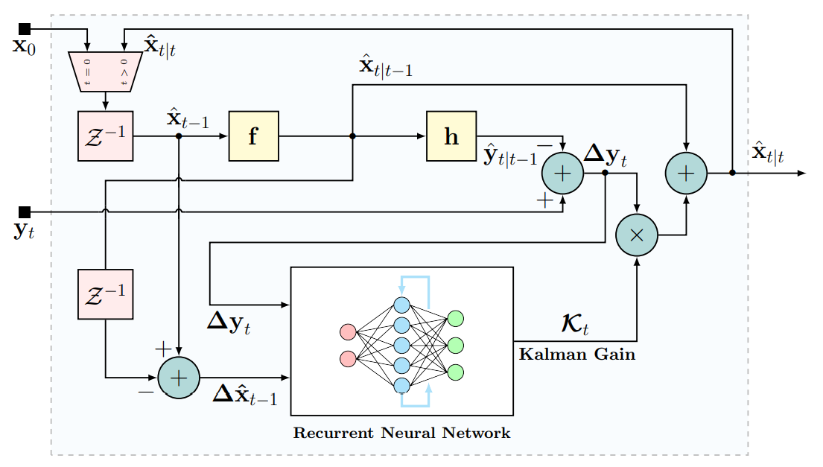
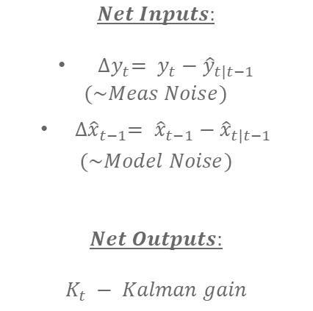
Related Works: Kalman Net block diagram
$$Net Inputs:$$
${∆y}_{t}= {y_{t}−\hat{y}}_{t|t−1}$
$(\sim Meas Noise)$
${∆\hat{x}}_{t−1}= {\hat{x}}_{t−1}−{\hat{x}}_{t|t−1}$
$$(\sim Model Noise)$$
$$Net Outputs:$$
$$K_{t} − Kalman gain$$
$$x −State \left| \hat{x} −Est. State | y −Measurment \right| f −evolution function \left| h −Trans. matrix \right| Z^{−1}−Unit delay$$

Slide 9
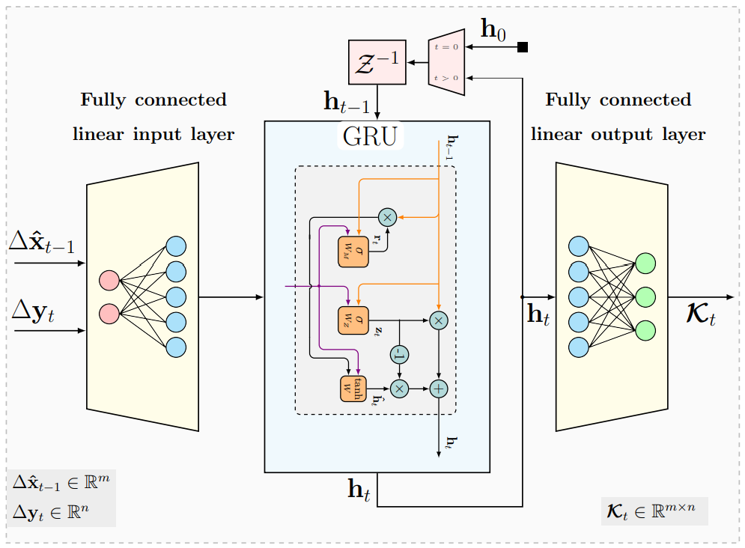
Related Works: Kalman Net – Architecture #1
Net Architecture: Fully connected → Single GRU layer → Fully connected
5·10⁵ trainable parameters

Slide 10
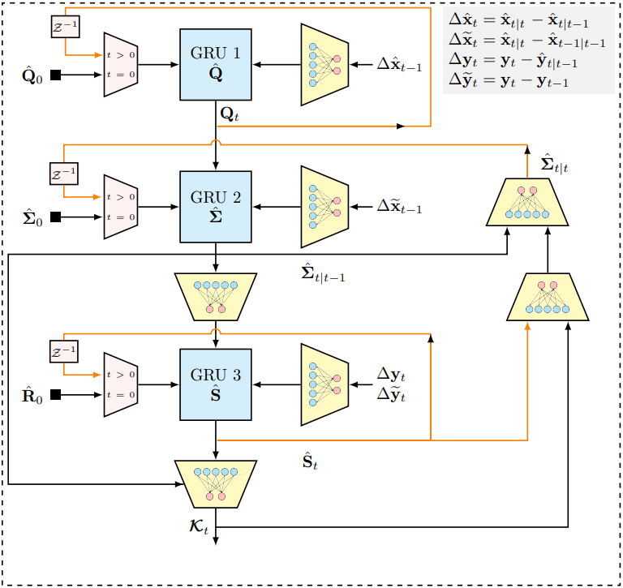
Related Works: Kalman Net – Architecture #2
Net Architecture: Separate GRU cells for each of the tracked second-order statistical moments
The network composes three GRU layers, connected in a cascade with dedicated input and output FC layers.
This architecture is more directly tailored towards the formulation of the state space model and the model based KF
2.5 · 10⁴ trainable parameters

Slide 11
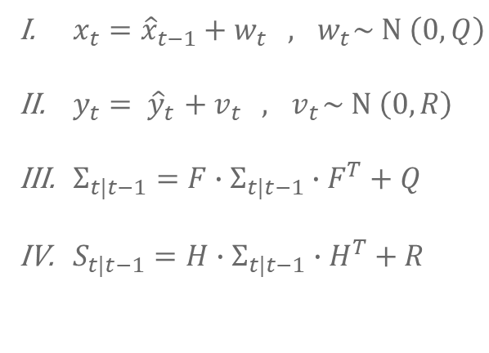
Related Works: Kalman Net – Architecture #2
$x_{t}={\hat{x}}_{t−1}+w_{t} ,{ w}_{t}\sim Ν \left(0,Q\right)$
$y_{t}{= \hat{y}}_{t}+{ v}_{t} ,{ v}_{t}\sim Ν \left(0,R\right)$
$Σ_{t|t−1}=F∙Σ_{t|t−1}∙F^{T}+Q$
$S_{t|t−1}=H∙Σ_{t|t−1}∙H^{T}+R$

Slide 12






Our Approach: Transformers Net
Our approach to implementing the network inspired by the second architecture from “KalmanNet”
The main advantage of this implementation was the possibility to introduce a large number (“n”) of states and measurements for each processing step
Several “n” values was tested with to optimize the system
The idea in planning the detailed architecture was that the processing time would be the same as the reference and through intuition and rules of thumb
$\text{4.6}\text{·}\text{103}$ trainable parameters
$$K_{t}$$
Encoder
Decoder
$$\left[\begin{matrix}{∆\hat{x}}_{t−1} \\ {∆\tilde{x}}_{t−1}\end{matrix}\right]$$
$$\left[\begin{matrix}{∆\hat{x}}_{t−n} \\ {∆\tilde{x}}_{t−n}\end{matrix}\right]$$
$$\left[\begin{matrix}y_{t} \\ {\tilde{y}}_{t}\end{matrix}\right]$$
$$\left[\begin{matrix}y_{t−n} \\ {\tilde{y}}_{t−n}\end{matrix}\right]$$

Slide 13
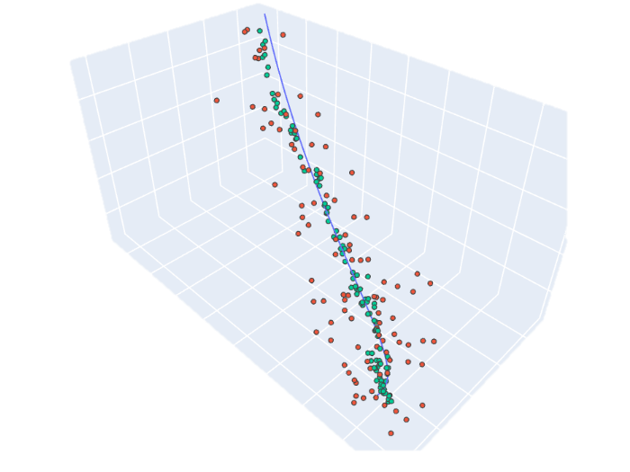
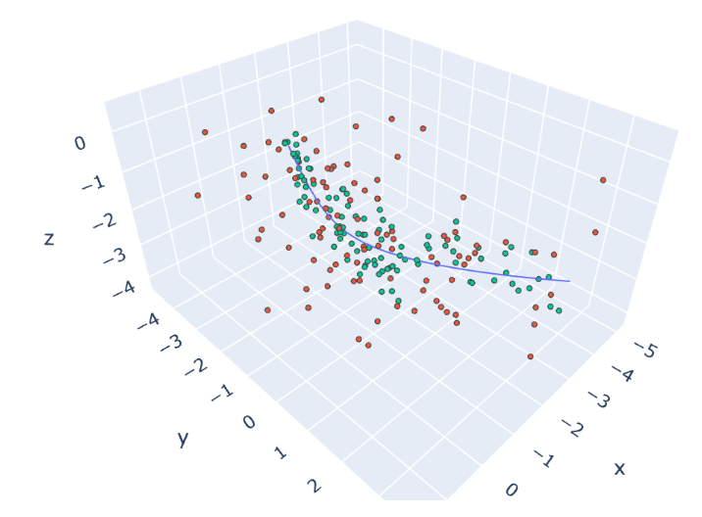
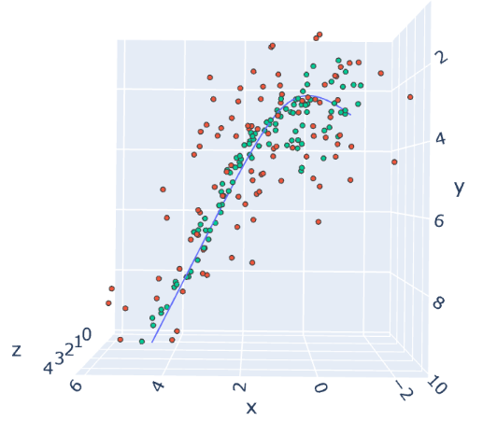
Results: Examples (6 x set of data)
Straight Line
Soft turn
Sharp turn
Red – Measurements | Green – Kalman Output | Blue – Ground True

Slide 14
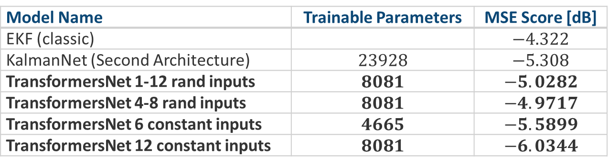
Results: MSE & Conclusions
The transformers network got the best MSE at the same processing time (GForce980m)
The performance of the network in addition to the significant differences in the number of parameters was achieved with a basic and initial configuration.
Model Name | Trainable Parameters | MSE Score [dB]
EKF (classic) |  | $$−4.322$$
KalmanNet (Second Architecture) | $$23928$$ | $$−5.308$$
TransformersNet 1-12 rand inputs | $$8081$$ | $$−5.0282$$
TransformersNet 4-8 rand inputs | $$8081$$ | $$−4.9717$$
TransformersNet 6 constant inputs | $$4665$$ | $$−5.5899$$
TransformersNet 12 constant inputs | $$8081$$ | $$−6.0344$$

Slide 15
end
Idan Daniel & Mor Keshet

Slide 16
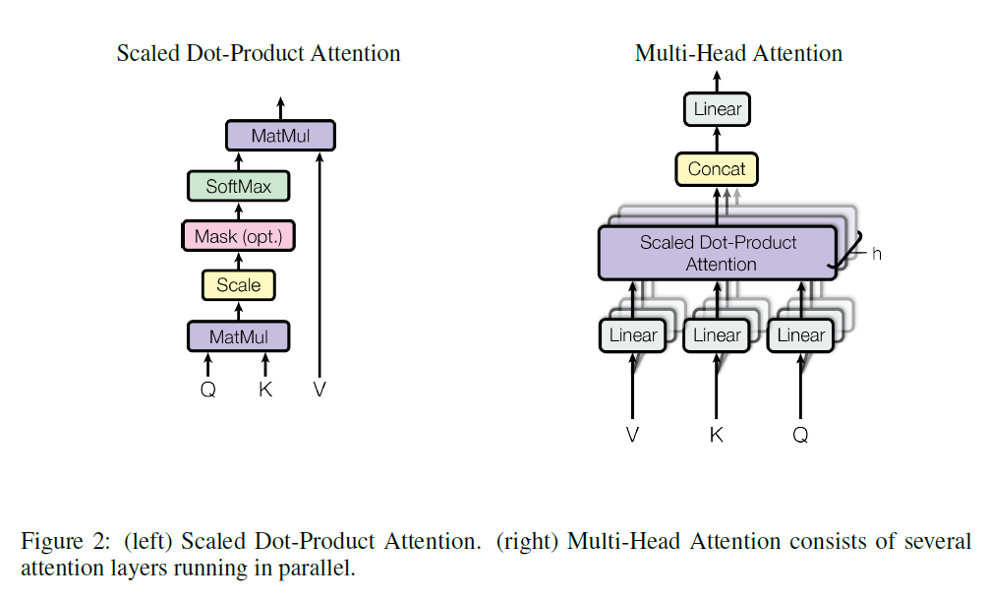
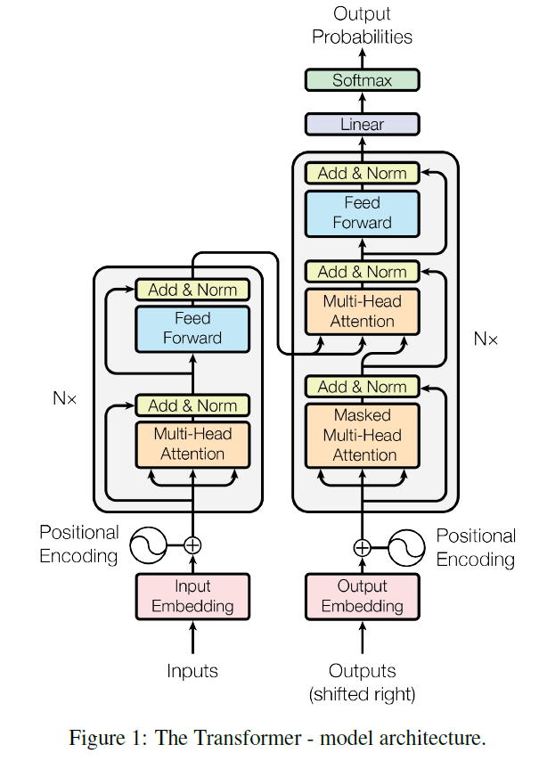
Introduction: Transformers Block Diagram

Slide 17
Professor Raja Jeris (TAU) insights
Different approach to train the model.
Use the full transformer structure (more trainable parameters).
Adaptive model (add or reduce the memory decisions).
Likelihood model.
Optimized transformer.

Slide 18
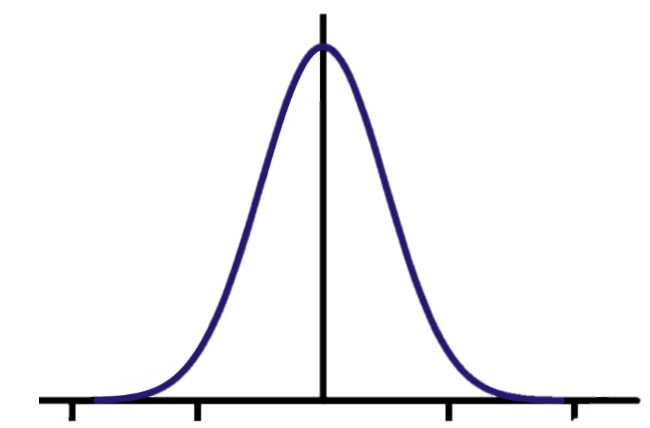
Transformer Net
Measurements
Noise mean est.
Human who have map of measurements and ask to point over the ground true, he calculates the noise of the measurements and point at a reasonable state somewhere in the middle of the measurements.
Separate the inputs into groups.
Calculate the value of each value and use it according to its correlation in the group.
Human mean noise estimation by using measurements over time. Part of the process is grouping the measurements for upper and lower groups as expected from Self-Attention mechanism.
Measurements
Values
Excepted transformer noise detection. Using the self-Attention will separate the measurement into upper and lower groups, we except the values to be the estimated distance from the ground true state.

Slide 19
Projects
Implement as black box in all trackers.
Use on video processing.
Use more features.
Build on GPUs.
Start point and structure (workflow) to fit different projects.

Slide 20
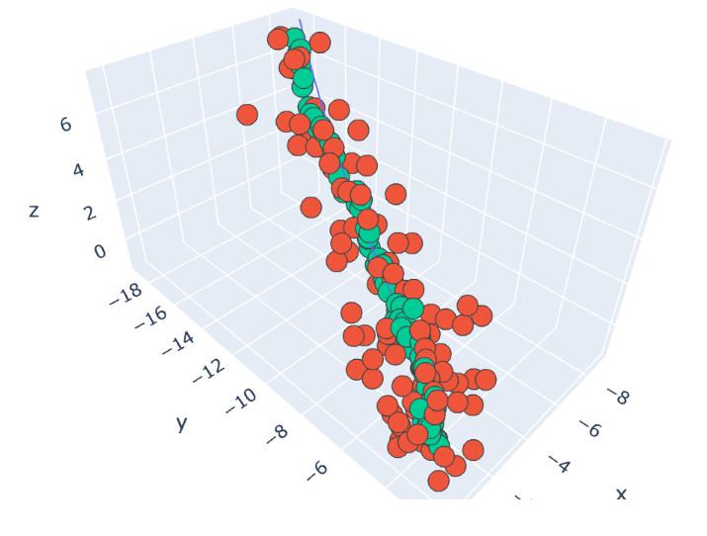
Straight Line Trajectory
Red dots symbol the noisy measurements that input to the model every time step. Green dots Symbol the model outputs. Blue line is the ground-truth trajectory that the model needs to estimate.
Straight line trajectory has the best estimation as expected because it’s the easiest pattern, moreover by the visualization we can notice that we have bias for areas with measurement that are not isotropic from all the directions around the ground truth line.

Slide 21
Soft-Turn Line Trajectory
Red dots symbol the noisy measurements that input to the model every time step. Green dots Symbol the model outputs. Blue line is the ground-truth trajectory that the model needs to estimate.
while estimating soft-turn the model preform decrease but it is clear that the outputs coverage to the ground truth and the outputs have smoothed the measurements.

Slide 22
Sharp-Turn Line Trajectory
Red dots symbol the noisy measurements that input to the model every time step. Green dots Symbol the model outputs. Blue line is the ground-truth trajectory that the model needs to estimate.
While having the sharp turn we notice that the model underperforms and wasn’t able to smooths the measurements well.
We suggest that one of the reasons is that the model has the same standard deviation of noise over all the axis and by turning sharply the measurements can match the sharp turn measurements but also continuation in the same direction.

Slide 23
Introduction: Eextended Kalman Filter Block Diagram
Orig. Error Est.
Orig. Est
Data Input
Error in Est.
Error in Meas.
Prev. Est
Measured Value
(1) Kalman Gain Calc.
(2) Current Est. Calc
(3) New Error Cal.
Update Est

Slide 24
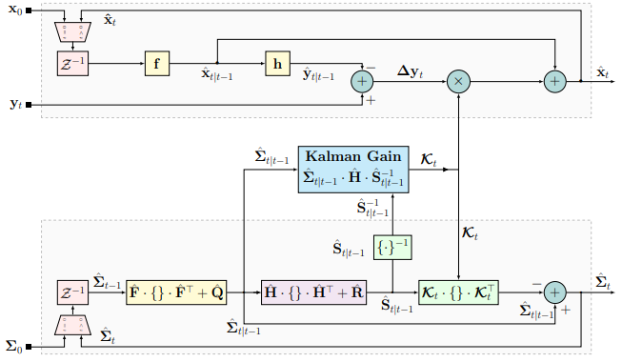
Introduction: Extended Kalman Filter block diagram

